Slide 1
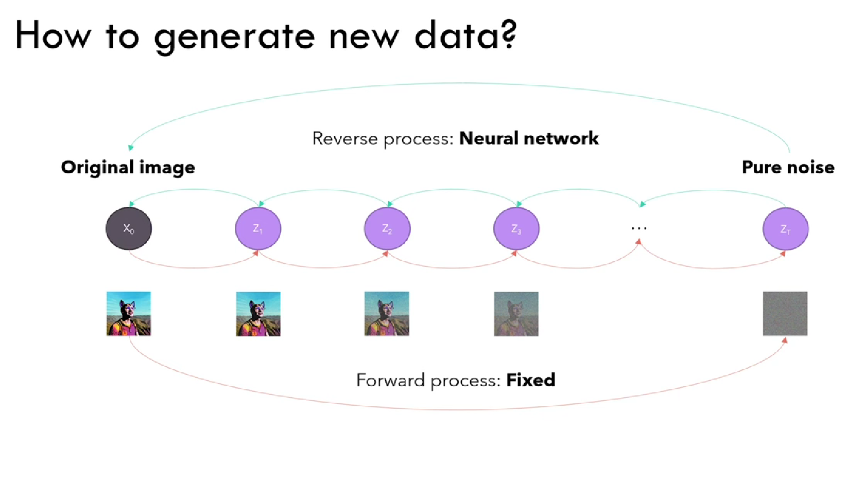

Slide 2
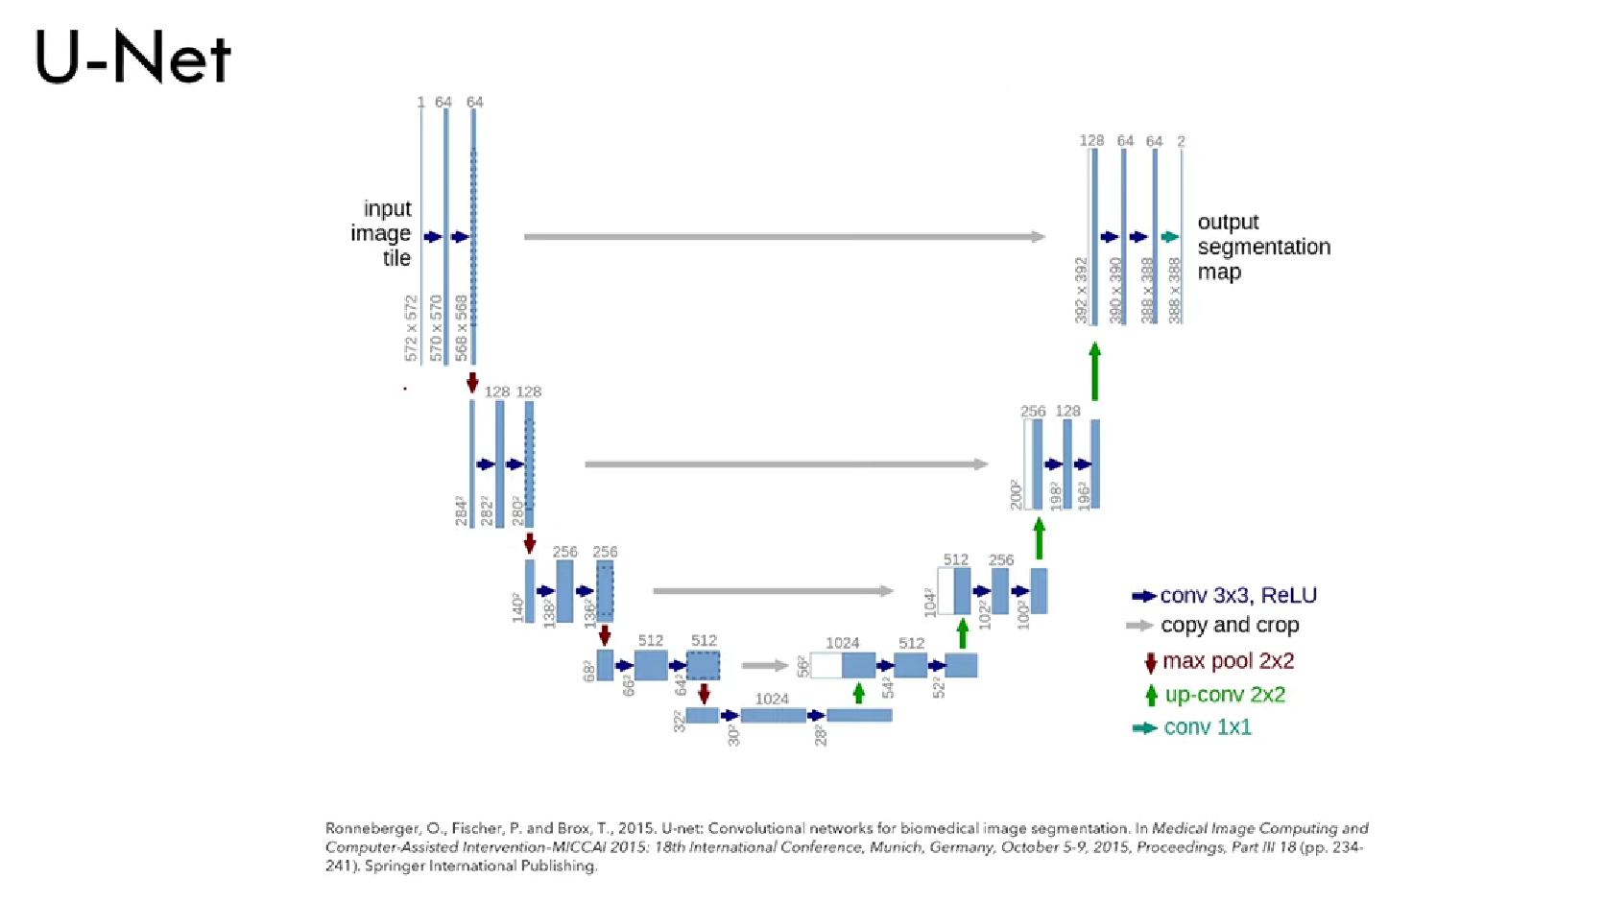
Image
Image + Prompt

Slide 3
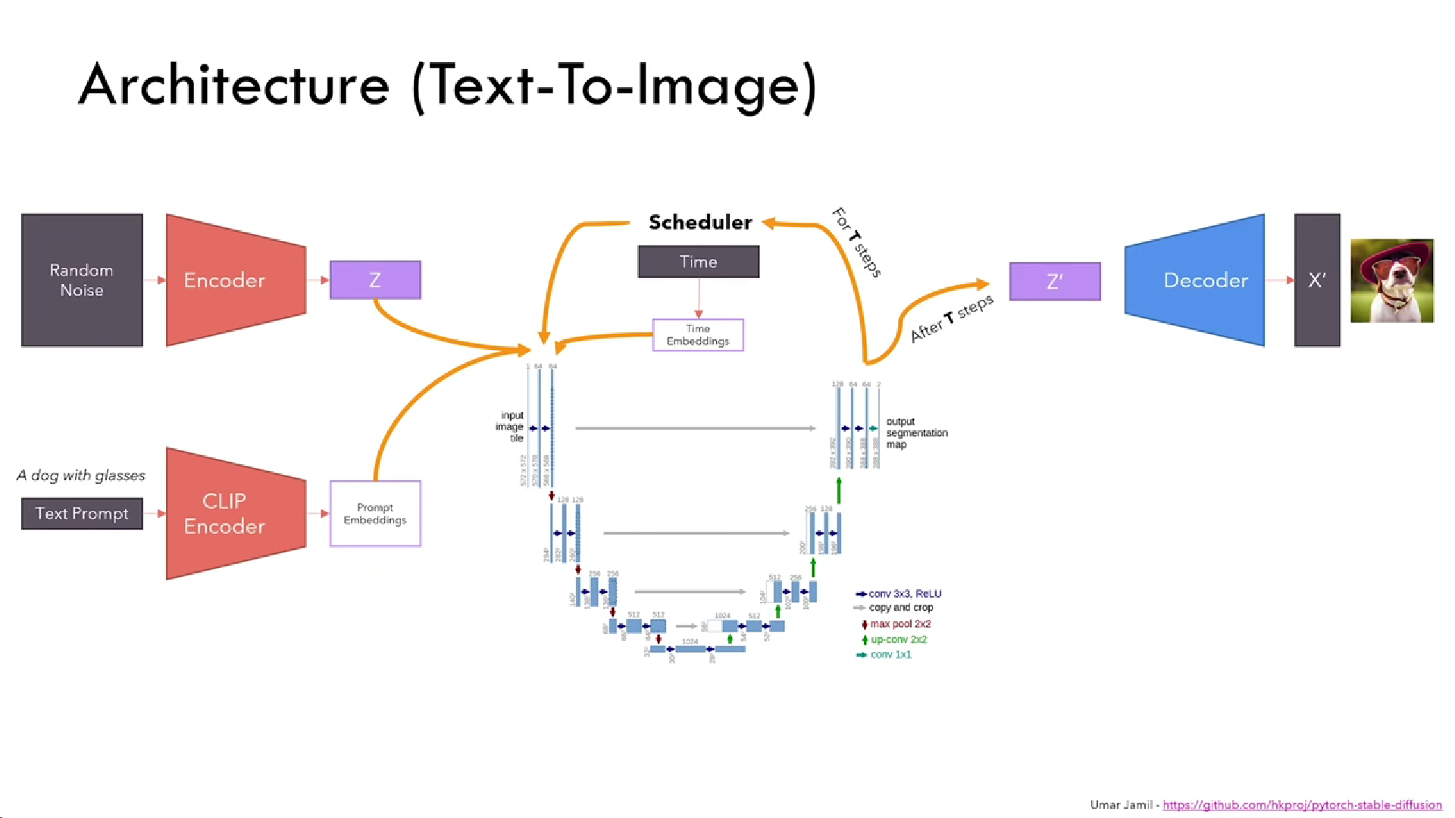
Reduce the size of img with each level
But increase quality/colors

Slide 4
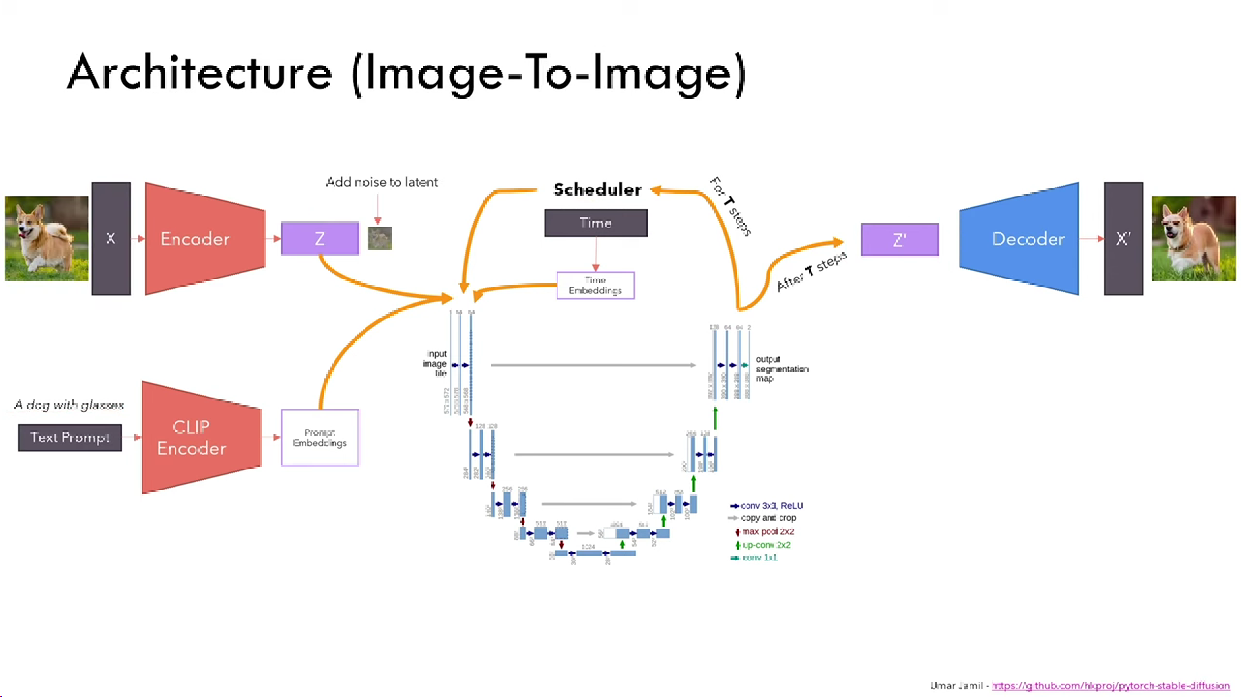

Slide 5
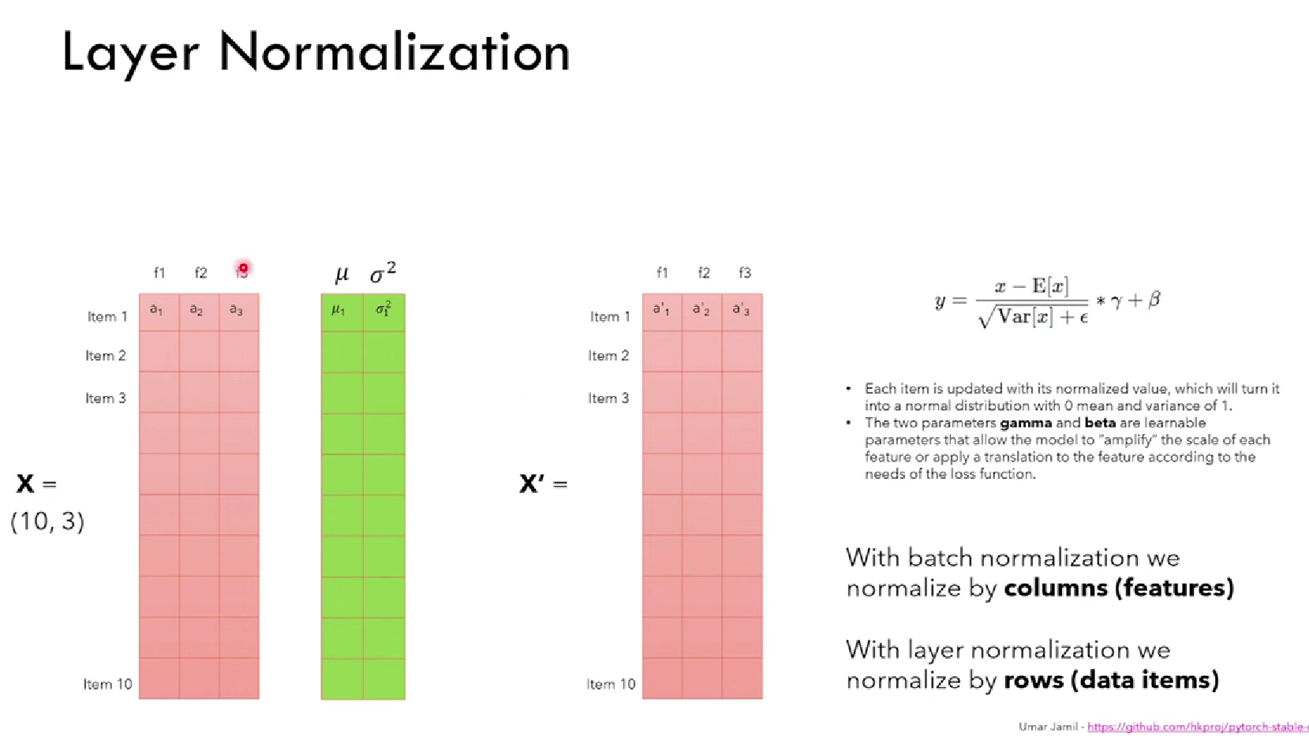

Slide 6
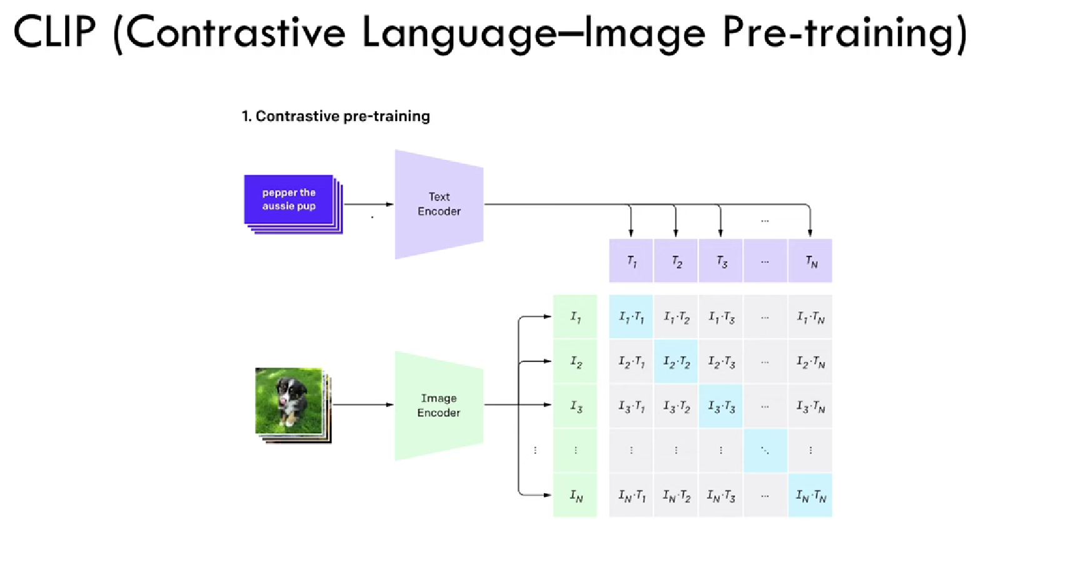

Slide 7
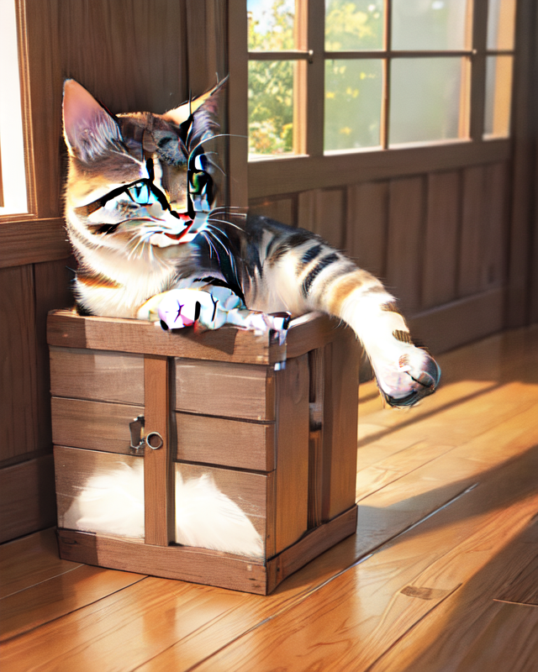
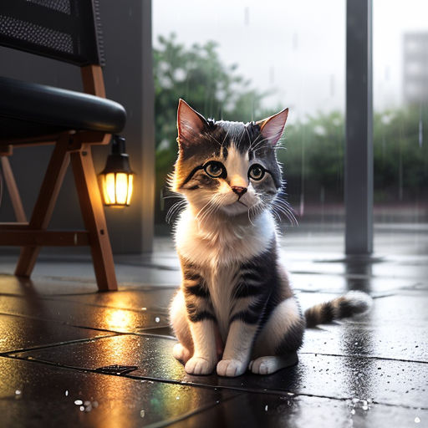
Prompt : A cat sitting on the floor, highly detailed, ultra sharp, cinematic, 100mm lens, 8k resolution
Base Model
Optimized Model (Version 1)

Slide 8
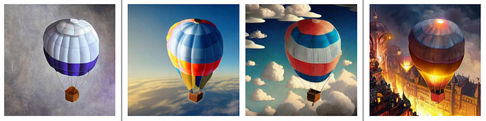
Prompt : A hot air balloon in the sky, clouds, warm lighting, highly detailed, cinematic, 8k resolution
Original img strength = 0.9 strength = 1.5 strength = 3.8

